Slide 1
Chapter 43

Slide 2
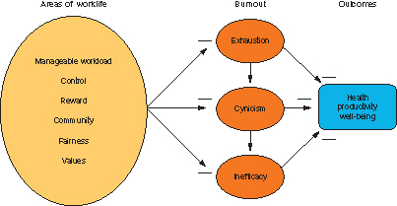
Figure 1 The mediation model of burnout.

Slide 3
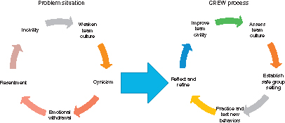
Figure 2 The CREW process as a response to community mismatches in a workgroup.

